Slide 1
Daily Diet Log Analyzer
PROJECT - 3
MADE BY – UDITYA SETH
ROLL NO – 2312RES962

Slide 2
Introduction
A Daily Diet Log Analyzer is a tool/system designed to track, analyze, and interpret a person’s daily food and beverage intake.
It helps users become more aware of their eating habits and understand how their diet aligns with their health and fitness goals.
The analyzer can calculate nutritional values (calories, protein, fat, carbohydrates, vitamins, etc.) from logged meals.
It supports data visualization, making it easier to identify patterns, deficiencies, or excesses in diet.
By providing insights, it serves as a digital nutrition assistant for promoting balanced eating and lifestyle improvement.
Objective
To provide a systematic record of daily dietary intake.
To analyze nutritional content (macronutrients and micronutrients) of the logged food items.
To identify dietary imbalances, such as excess calories, low protein, or vitamin deficiencies.
To support personalized health goals (weight loss, muscle gain, diabetes management, etc.).
To enhance self-awareness about eating habits and lifestyle choices.
To generate reports and insights that help users make informed dietary decisions.
To encourage long-term healthy eating patterns through consistent monitoring and feedback.

Slide 3
# PROCESS
1 I HAVE GENERATE DATA SET
THEN ACCORDING TO INSTRUCTIONS
I HAVE CLEAN IT
THEN I HAVE ADD A NEW MEASURE OF AVERAGE DAILY CALORIES AND TOTAL CALORES IN MY DATA SET
THEN I HAVE USE A DONUT CHART WHICH SHOW TOTAL CALORIES PRESENT IN MEAL
THEN I HAVE USE A LINE CHART SHOW CALORIES PRESENT IN MEAL IN A DAY OR MONTH
THEN I HAVE USE A STACK BAR CHART TO COUNT A FOOD BY MEAL
THEN I HAVE CREATED THE CARDS ACCORDING TO MY PROJECT
THEN I HAVE USE A SLICERS AND BUTTON SLICER FOR DIFFERENT CONDTION ACCORDING TO MY PROJECT
AT LAST I HAVE FULL FILL ALL CONDITIONS WHICH IS REQUIRED FOR THS PROJECT.

Slide 4
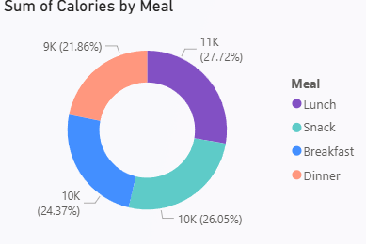
TOTAL CALORIES PRESENT IN MEAL

Slide 5
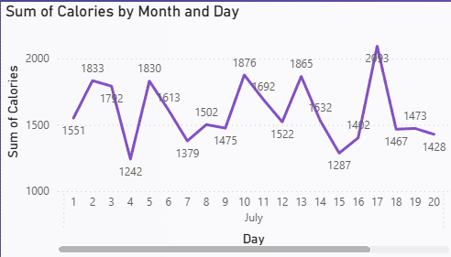
TOTAL CALORIES PRESENT IN MEAL OF DAY|MONTH

Slide 6
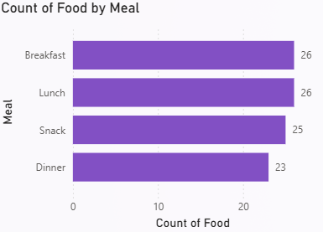
COUNT OF FOOD BY MEAL

Slide 7
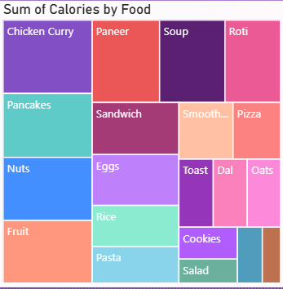
SUM OF CALORIES PRESENT IN FOOD

Slide 8
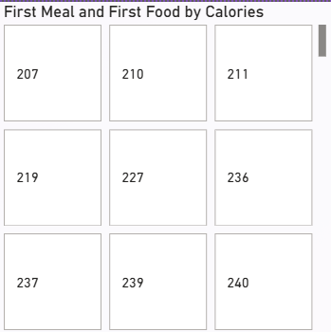
BUTTON SLICER OF CALORIES WHEN WE
CLICK ON IT UPDATE THE REPORT ACCORDING TO
THE FILTER

Slide 9
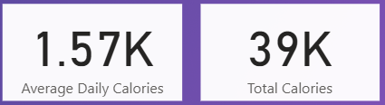
CARD I HAVE USED HERE ACCORDING TO
PROJECT

Slide 10
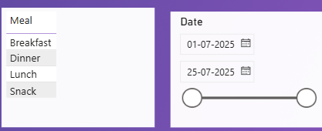
SLICERS WHICH I HAVE USE ACCORDING TO PROJECT

Slide 11
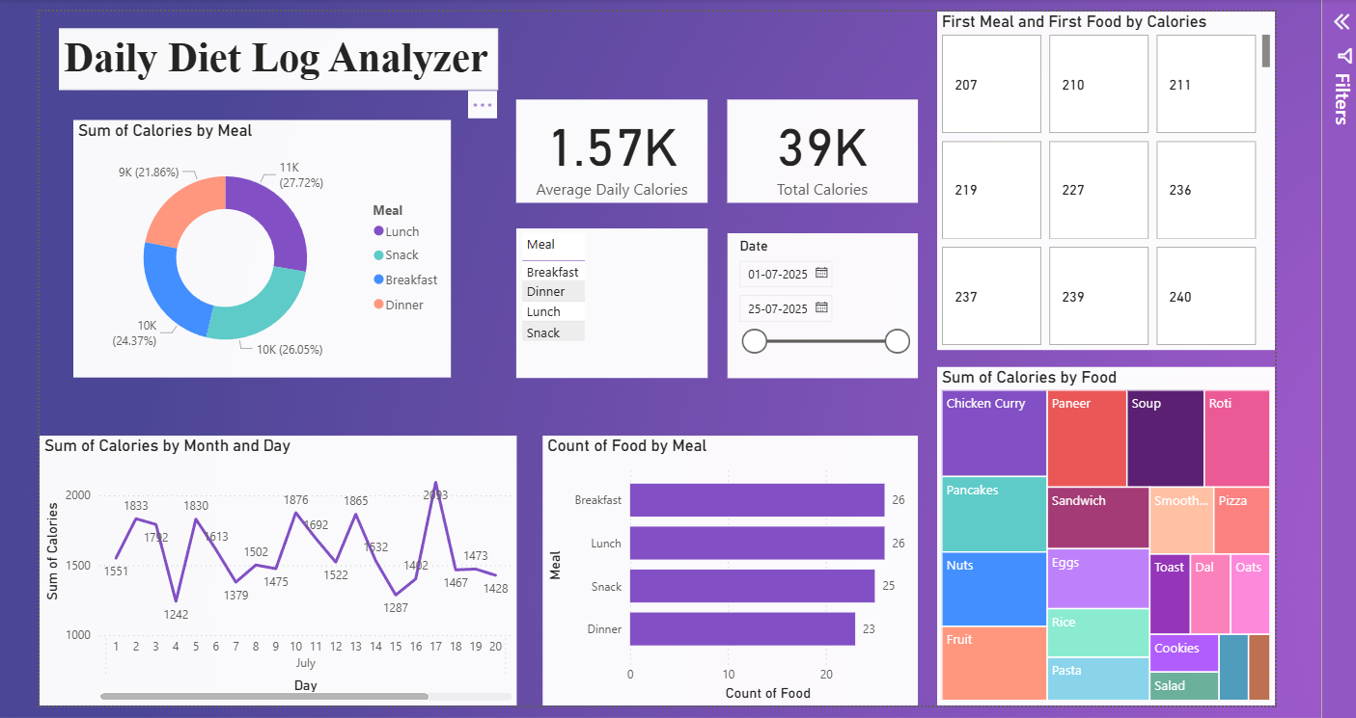
DASHBOARD

Slide 12
THANK YOU

